Slide 1



MULTIMEDIA and COMMUNICATIONS
Computer Science CS1033a/b
Lecture #7
Marketing the Website
Search Engines
A little History
Instructors:
Laura Reid (section 001)
Vivi Tryphonopoulos (section 002)

Slide 2
Today’s Lecture
  Lecture 7 (Search Engines)
Moving your website to the server
Helping people find your website
Search Engines
Subject Directories
How do search engines find your webpage?
Some cool Google stuff
Website Statistics
Some more Internet history

Slide 3
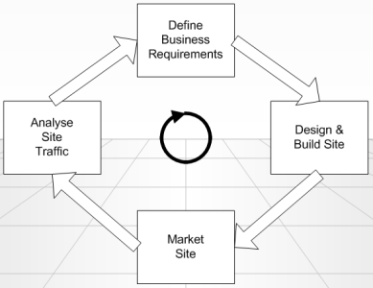
Publishing Your Website
Once you have created a website on your hard drive you need to get it up on to the Web. This is called “uploading” or “publishing” or “ftp’ing”
Stages of creating
a Website
Make it Internet
Ready
Available for
everyone to see
Publish

Slide 4
Publishing your website
involves transferring the web page file(s) to the web server
What you need?
Use FTP software
(File Transfer Protocol)
An internet standard that allows you to upload and download files with other computers on the Internet
Important: NOT all FTP software can connect to a web server (security, firewalls,etc)
Added Features:
Via FTP software can delete, rename, move,and copy files on a server.
Stages of creating
a Website
Publish
ANY FILE MANAGEMENT OPERATIONS

Slide 5
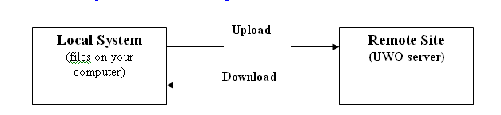
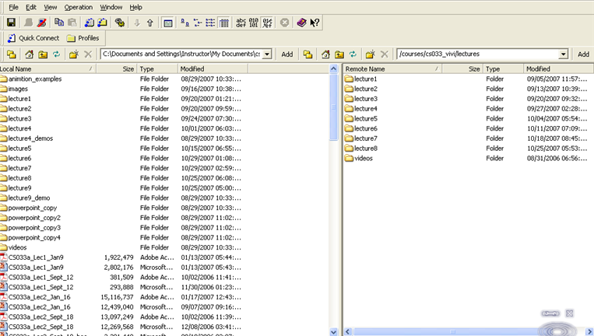
Publishing Your Website
Internet Provider host
Downloading: process of receiving a program, document or file
via a network from another computer
Remote Site (server) → Local Computer
Uploading: Local computer → Remote site (server )

Slide 6
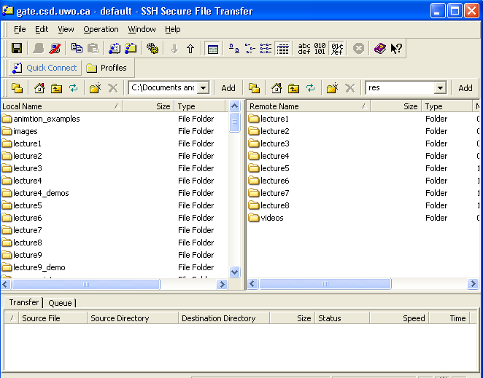
Notes:
No need to know

Slide 7
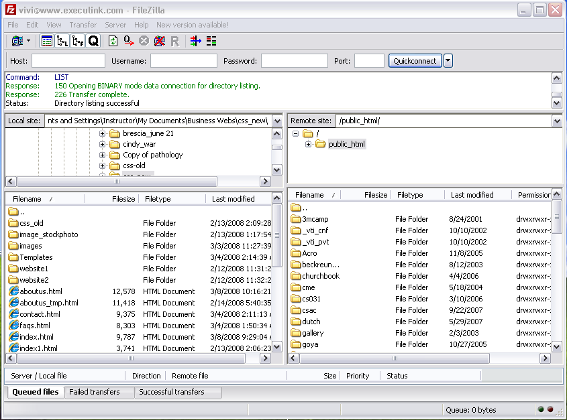
Publishing your website
Find out which FTP clients are compatible with their web server
Not all FTP clients will connect to a server
Other FTP applications:
Secure Shell
Filezilla
Mac-based: Fugu
FileZilla
Notes:
No need to know I think

Slide 8
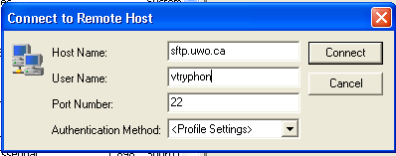
Publishing Your website
Need 4 pieces of information from web host:
  Host name
    check for the proper address provided by your Web site's Host
    panther.uwo.ca, ftp.tripod.com, ftp.nbci.com
    ftp.hometown.aol.com
  Username
  Password
  URL or Web page address
  Port number
Notes:
Know these

Slide 9
Stages - Marketing
Marketing

Slide 10
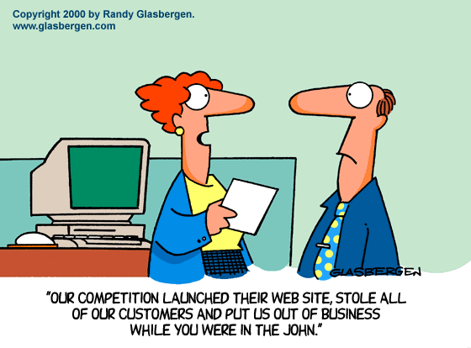
Stages Marketing

Slide 11
Stages: Marketing
How should I promote my website?
Include the website address:
Part of your 'signature' on all out-going e-mail.
Browser Searches:
Try
to make your website be in the “Top 10” of a search engine ranking list
  HOW??
On all printed materials - letterheads, business cards, labels, catalogues, media advertisements, etc.
Website address is included on all advertisements.
Smaller, cheaper advertisements, but maybe more frequently, or in more media, can be highly effective when combined with a good website.

Slide 12
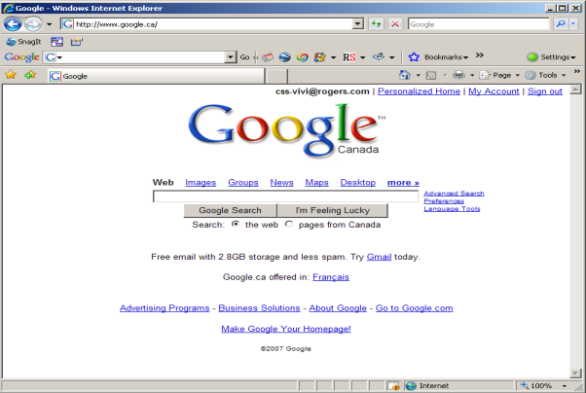
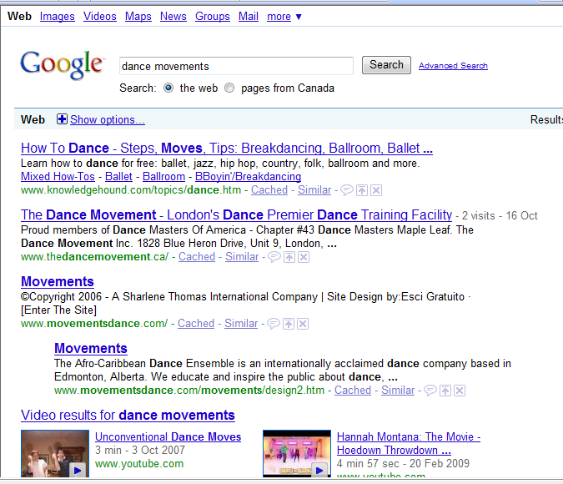
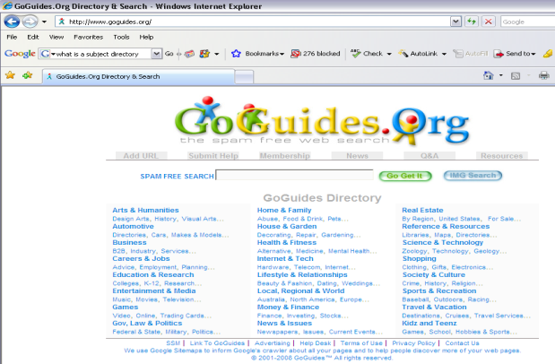
Finding information on the Internet
Use of a program that searches the internet for topics or keywords
(ie. Google, Yahoo etc.)
Points you to the sites
Question: There are two basic types of searches you can perform on the world wide web, what are they?
Directories vs Search Engine

Slide 13
Examples of _________________
Google! and its advanced search option
All the Web: (formerly FAST Search) and its advanced search option
AltaVista, its advanced search, and its text-only search (formerly Raging Search) options
AOL Search
Ask Jeeves
Search.com
Starting Point
HotBot and its advanced search option
iWon and its advanced search option
Lycos and its advanced search option
MSN Search and its advanced search option
Netscape Search
Overture (paid listings)
Teoma
Question: What new search engine is getting a good share of the searching market? Hint: The Colbert Report

Slide 14
Examples of _________________
GoGuides – $69 one time.
Wow Directory – $43 for a permanent listing.'
Jayde – Submission is free.
Ezilon – $69 annual fee of $199 permanent
aeiwi
Galaxy
Open Directory project (dmoz.org)
SearchKing
SunStream – $29 annually or $49 permanent.
Alive – $75 annual fee or $225 permanent.
01 Web Directory – Free submission option or $49 one-time for a guaranteed 3-day response time.
Aviva – $50 annually or $150 permanent.
.
Notes:
Not really important

Slide 15
Finding information on the Internet
http://www.searchengineshowdown.com/reviews/
Search Engine
Google, Alta Vista, Hotbot
A program that enables the user to search Internet sites
User types keywords– list of websites is returned
Returns a list of the websites where the keywords were found (best /most appropriate match )
Subject Directories
GoGuides, Wow,
Open Directory
A program that enables the user to search Internet sites
User chooses a subject of
interest and follows one category, subcategory .. until you reach the website
SAME THING
85% of people find sites thru Search engines

Slide 16
How is information organized?
Search Engines
Google, Alta Vista, Hotbot
Uses software called
spiders, webcrawlers
Gathers information: goes from web page to web page via links, looking at all the words on the page, building an index (database):
Index contains list of :
  alphabetical list of words it finds
  where within the page the word was
  the links (URL to the page) where it found the words (keywords)
Search engines searches the database of information
Subject Directories
Yahoo, About.com, AOL ,
Open Directory
Webmaster submits website to Subject Directory
Human editors review web pages and if decide if “worthy”
rank them, organize them into categorized lists organized by subject/topic
Note: Yahoo charges 299 dollars for you to submit your site
This charge just speeds up the process of having an editor judge it, it does NOT guarantee the editor will include it in the directory!
Notes:
Ignore yahoo note

Slide 17

How does Google work?
STEP 1: Gathers the information
Crawl and index the billions of pages of the World Wide Web.
This job is performed by Googlebot, a “spider” which connects to web servers around the world to fetch documents.
The spider collects information for the database (index)
Notes:
Lots of exam questions on this part of lecture

Slide 18
How does Google work?
STEP 2: Build an database (index)
Each website is given an “id number” or index number
Index Number | Website found on
1 | http://www.antartic.org/index.html
2 | http://www.worldaidforafrica.org/info.html
3 | http://www.worldwiderefuge.org/animals.html
4 | http://www.csd.uwo.ca/~lreid/resume.html
5 | http://www.AnimalsRUs.com
Database (index) might look something like this:
keyword | Index: Page and position within page
aardvark | 3 (body, 2nd word, 8th word) | 5(body, 12th word) | 20
africa | 2 (title) | 7 (… | 19 | 27 | 30
anteater | 2 (title, body 1st word) | 3 (… | 5 | 7

Slide 19
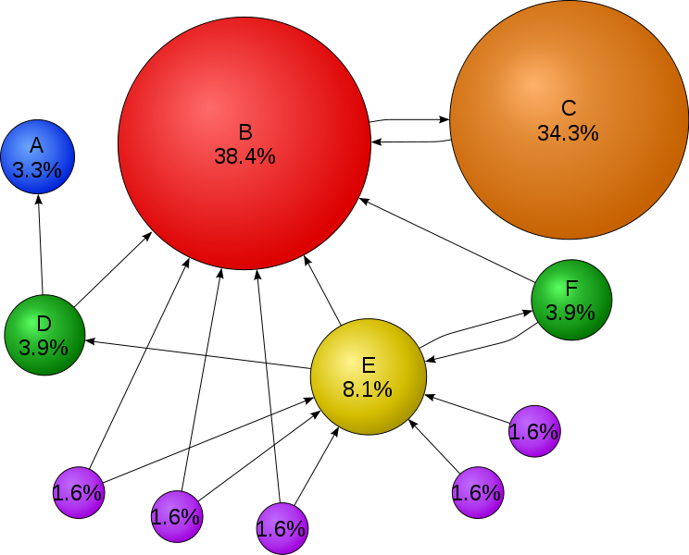
How does Google work?
PageRank algorithm:
Algorithm gives a weight to each webpage returned from the keyword search
Weight between 0 and 1
The higher the weight
the more likely it is that this page will be displayed first to you.
STEP 3: Rank Results
How does the search engine decide which pages to return to the searcher?
SE (search engine) uses index database to decide which pages have the given keywords
Every engine uses slightly different algorithms to decide the order of displaying the returned pages
Google uses the “PageRank” algorithm as ONE of the factors to decide what order to present the pages it found to you.
Notes:
Bubbles, %’s , number one ranking is B, higher percentage, C 2nd, E next, D, F (tie, will learn about ..)

Slide 20
How
PageRank Works
PageRank evaluates two things:
  How many links there are to
  a web page from other pages
  More links to it→ more Important
  First, assume we only have 4 pages, Page A, Page B, Page C and Page D on the Internet to simplify this.
  Each page is given a weight of 0.25 (1 divided by 4)
  Scenario 1:
    Pages B, C, and D all have a link to Page A. (Thus page A must be very useful because everyone is pointing at it).
    Then pages B, C and D are each giving their 0.25 rank to A,
    So A gets a ranking of 0.75 (.25 + .25 +.25)
B
Weight=0
A
Weight= .75
C
Weight=0
D
Weight=0
Notes:
Diagram structure, ask what’s the rak

Slide 21
How
PageRank Works
  Scenario 2:
    Page B links to A and C (0.25 divided between 2 pages) = .125
    Page C just links to A (all of 0.25 goes to A) = .25
    Page D links to A, B and C (0.25 divide between 3 pages) = .083
    The Weight of A is now:
      0.25/2 (Bs ranking ) + 0.25 (Cs ranking) + 0.25/3 (Ds ranking)
      0.125 +0.25 + 0.083 = 0.458
A Weight= B &C &D
= 0.458
B
.083
B Weight= D’s Ranking
= 0 .083
A
Weight= .458
C
.208
C Weight= B &D
= .125 + .083
= 0.208
D
Weight=0
Notes:
Won’t give us #’s
Look at arrows and see who has more people pointing to them
To rank

Slide 22
Summary of Page Rank
Page Rank evaluates 2 key factors:
  How many links are there to a web page (who’s pointing to you)
  What is the quality of the linking sites (although a high ranked page with LOTS of links on it may pass you )
Page Rank does not take into account the content of the page (thus frequent content updates don’t improve Page Rank necessarily)
Page Rank ranks web pages NOT web sites
Each inbound link is important in the overall total except for banned site, they don’t count.

Slide 23
How can I improve the Ranking of a website in a search engine?
SEO – Search Engine Optimization
In other words:
How do I get my page higher up on the results page that Google returns?
3 Components you should look at when you are trying to make your site more visible are:
  Text
  Links
  Popularity

Slide 24
Search Engines use:
- the placement of keywords to weight the webpage when deciding which pages to return in the top positions
- as well as PageRank algorithm weighting
Not as important:
- Alternative Text
- Text in domain
- Name/filenames
- Meta tag (least important)
SEO – Search Engine Optimization
Text: Keywords
  STEP 1: IDENTIFY THE CRUCIAL KEYWORDS
Users will type a set of words or phrases into the a search engine box to find what they want
Know what they are
  STEP 2: PUT KEYWORDS IN BEST LOCATIONS
  Title (Property Title)
  Visible Body
  (the text you can cut from a page and paste into Notepad)
  Text around and in links
  Text that is above the fold (first screen)

Slide 25
Identify Crucial Keywords
Five-Second Usability Test:
  Show people your site for 5 second
  Write down keywords they remember
  Result: If they did not write down any of your keywords, then you need to redo your sire
Brainstorm to find keywords, use your marketing and see what pops out.
Think about how people might combine your keywords
HINT: keep updating your keywords:
  Question: When do users commonly search for the word allergies?
Notes:
Fluff slide

Slide 26
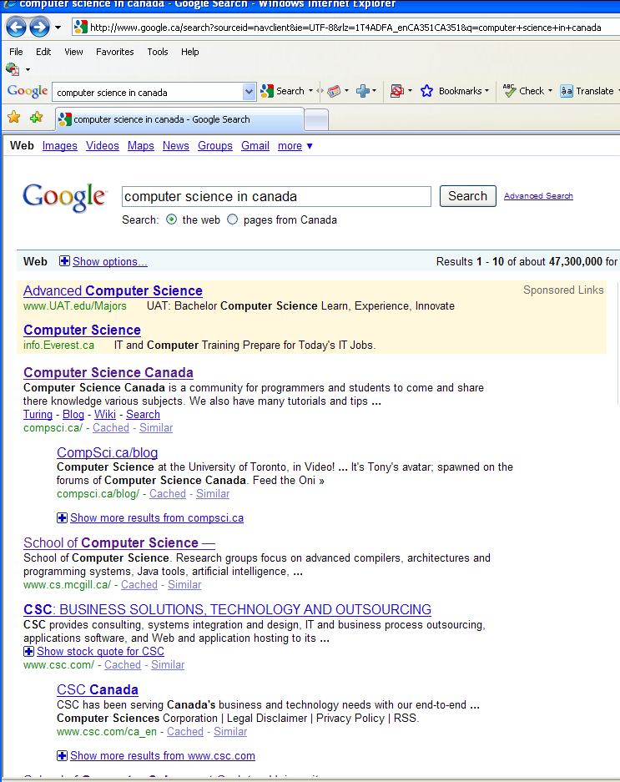
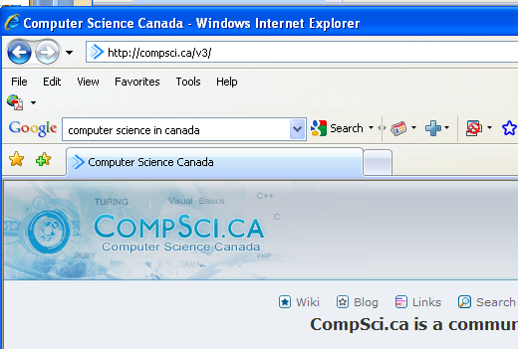
Title-Tag (Property Title)
is considered the MOST important text by all search engines
Title tag is what is shown as the link for all returned results
Title tag is text shown when people bookmark your site
Notes:
Could be on exam

Slide 27
SEO – Search Engine Optimization
Text: Body of the Webpage
Search engines will look at:
Keyword Stuffing
A simple site about cats: http://www.csd.uwo.ca/~lreid/cs1033/keywordstuffing.html
Question: How did I do keyword stuffing with the above page? (I did 2 things, can you find them?)
Moral of the story: you USUALLY can’t outwit Google, just use good content to win over your visitors!

Slide 28
SEO – Search Engine Optimization
Text: Body of the Webpage
Search engines will look at:
Keyword Prominence
Keywords found near the top of the page make the page more relevant and thus give those pages a higher ranking
Keyword Density also gives a higher ranking
Question: What do you think keyword density is?
Which Ranks lower?
Total number of words / Number of keywords
Thus a site with 800 words and 5 occurrences of text “dog”
= 800/5 = 160 (keyword is found every 160 words)
Thus a site with 200 words and 5 occurrences of text “dog”
= 200/5 = 40 (keyword is found every 40 words)

Slide 29
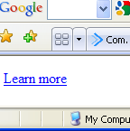
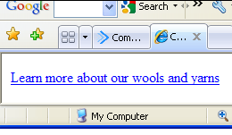
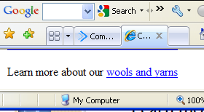
SEO – Search Engine Optimization
Text: Body of the Webpage
Text in and around links is used by search engines, for example:
  Instead of this
  <a href=http://www.yarnsandwools.com>
  Learn more</a>
  Do this:
  <a href=http://www.yarnsandwools.com>
  Learn more about our wools and yarns</a>
  Or this:
  Learn more about our <a href=http://www.yarnsandwools.com>
  wools and yarns</a>

Slide 30
SEO – Search Engine Optimization
Link Component
Make sure that your links are easy to navigate
- No broken links
- otherwise web spiders can’t search through your content easily and index ALL your content.
NOTE: It is hard for spiders to crawl through:
  Image maps
  JavaScript
  Database Driven Web Pages (ones with ?, &, etc in the URL that are created, CGI pages can be problematic)
  Links in Flash documents
  Poorly written html (don’t use MS Word, etc to write the html tags!)

Slide 31
SEO – Search Engine Optimization
Popularity Component
Popularity is broken into two parts:
  Link Popularity
    Quantity: Getting many links to your site
    Quality: Popular websites that link to you
  Click-through popularity:
  Measures how:
    How many times your site is clicked on
    How often a user returns to your site
    How long a user stays at your site
    Question: click through popularity is not used by some search engines to give a weight to a page, WHY?

Slide 32
Some tips to increase your popularity weighting
Get sites that highly on search engines
to link to your site
Submit your site to search engines ie. Yahoo directory.
Yahoo has a strong weighting!
Check your competitors web pages
Try to figure out why their site is ranked higher than yours.
  For example:
    Go to http://www.google.ca
    Search for Horseback Riding London Ontario
    Suppose I work for Circle R Ranch, why did my site not show up first?
    What if I search for Horse Riding London Ontario?
    Does it change the order of the listing?
    Things to consider(watch from 1m to 9m): http://www.youtube.com/watch?v=BPgZAUHVzdU
Notes:
Remember View Source for Exam

Slide 33
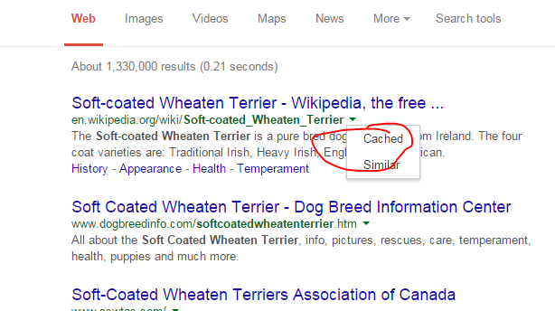
How can you get Google to find you faster?
Allow time!
With countless millions of pages on the World Wide Web it may take 2- 6 weeks for new sites or pages to get indexed in the database.
Submit your site to here: http://www.google.com/submityourcontent/#
Question: When you do a search in google, what happens if you click on cached?
For example, search for
Soft Coated Wheaten Terriers Dogs,
then click on the cache link → http://www.google.ca
  Hover over the green arrow next
  to the link:
Notes:
Not on exam

Slide 34
Review Videos on SEO
http://www.youtube.com/watch?v=NW1h_yh5_v0
http://www.youtube.com/watch?v=hF515-0Tduk

Slide 35
Other Fun Google Stuff!
Find out who links to you:
  Type link: www.csd.uwo.ca/~lreid/cs2212 in google
Find the time in another place:
  Type Time Abu Dhabi
Find the definition of a word:
  Type Define: egalitarian
Try this out in http://www.google.com
  Search for multimedia
  Now search for: multimedia site:www.uwo.ca
Notes:
Not on exam

Slide 36
Search Insights
https://www.google.ca/trends/
  How it works → http://www.youtube.com/watch?v=4uNrhACTv_c
Question: How about the top keywords for today? http://www.google.ca/trends/hottrends
  http://buzzlog.yahoo.com/overall/
Notes:
Fluff slide, not on exam

Slide 37

Usage Statistics
Why are statistics important?
Are you getting the traffic?
Analyze your stats from your IPS provider or from companies on line
Where Do Your Website Statistics Come From?
ISP: Web servers keep logs of all visitor activity
May be part of service or extra cost
Are you getting the hits?
Track the effectiveness of a marketing/advertising campaign
Determine where to fine tune your website content
Determine the effectiveness of your website navigation
Notes:
On exam

Slide 38
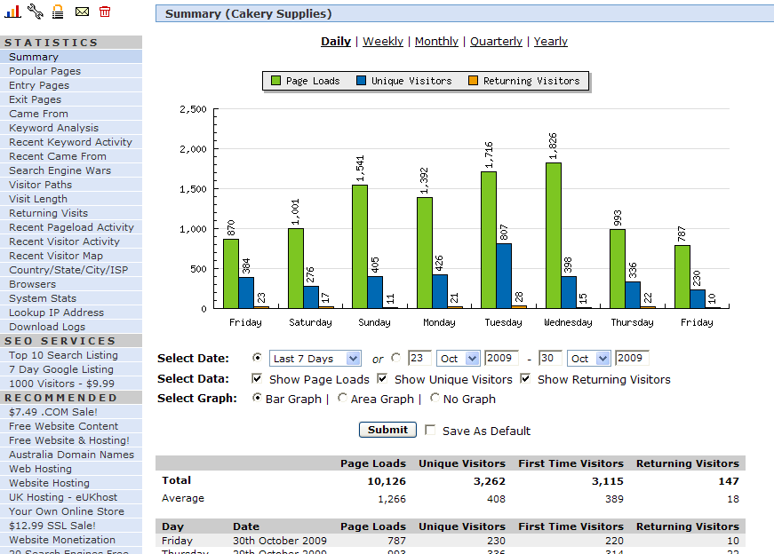
Usage Statistics: An Example
http://my7.statcounter.com/project/standard/stats.php?project_id=2368090
Entry page (page that
user enters your site)
Exit page (the last page
before leaving your site)
Here is a real report:
  Total Hits: 3,357
  Total Files: 1,441
  Total Pages: 413
  Total Visits: 337
Hits: Each file (includes html file, graphic files ) sent to a client
Pages: A webpage
Question: Which will always be bigger: hits or pages
Notes:
Hits doesn’t mean number of people visited

Slide 39
“Hits for a website”
(will let you write this down)
"We get 90,000 hits a month" on a web site?
A "hit" is not a visitor to the web site, it is
= # of graphics on page + page itself
If webpage has 89 small graphics
every visitor to the site registers as 90 hits
(89 graphics plus the 1 html file)
In this case:
If we have 90,000 hits (90,000/90= 1,000)
translates to just 1,000 visitors

Slide 40
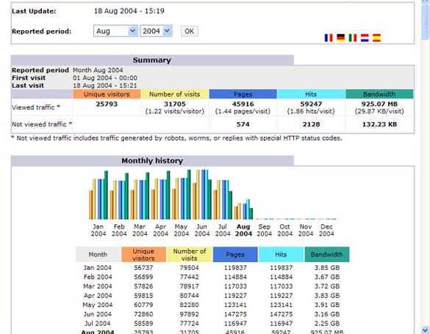
# of users to your site
# of distinct html filesor pages looked at
# of files sent to a user after a page request (includes graphic files)

Slide 41

History of “Searching the Net”
The first tool for searching the Internet, was called “Archie”. (short for “archives”)
The original implementation was written in 1990 by
Alan Emtage, Bill Heelan, and Peter J. Deutsch, then students at McGill University in Montreal.
Designed to index FTP archives, allowing people to find specific files.
the world's first Internet search engine and the start of a line which leads directly to today's Altavista, Yahoo!, and Google.
It downloaded directory listings of all files located on public anonymous FTP servers; creating a searchable database of filenames.
Original news announcement: http://groups.google.com/group/comp.archives/msg/a77343f9175b24c3?output=gplain
1990:
Alan Emtage

Slide 42

1991:
"Gopher" was created late spring
by Mark McCahill, Farhad Anklesaria, Paul Lindner, Dan Torrey, and Bob Alberti of the University of Minnesota
Gopher is a distributed document (shared by computers) search and retrieval network protocol designed for the Internet.
Its goal was similar to that of the World Wide Web, but now been become obselete
http://www.search-marketing.info/search-engine-history/#www
Mark McCahill

Slide 43

1991:
World Wide Web is developed at CERN
Tim Berners-Lee (Geneva, Switzerland)
Problem: Data was difficult to access and exchange due to differing encoding formats and networking schemes.
He works from several criteria:
  the system must be flexible, compatible with numerous languages and operating systems;
  the system must be capable of recording random links between objects;
  entering and correcting information is easily performed.

Slide 44


1995: APRIL
Founders of?
Yahoo
(subject directory)
Started in April 1994
management team:
  Tim Koogle, a veteran of Motorola
  alumnus of the Stanford engineering department as chief executive officer
  Jeffrey Mallett, founder of Novell's WordPerfect consumer division, as chief operating officer
  Started as a Search Engine and Web Directory
  Add things like Yahoo! Games and Yahoo! Messenger
David Filo
Jerry Yang

Slide 45


Founders of?
Google
(search engine)
1998: SEPT
brought to life in September 1998
  Based on the idea that “analyzed the relationships between websites would produce better ranking of results than existing techniques, which ranked results according to the number of times the search term appeared on a page” (www.wikipedia.org)
Larry Page
Sergey Brin

Slide 46
Google
Some more facts from www.wikipedia.org
Their search engine was originally nicknamed "BackRub" because the system checked backlinks to estimate the importance of a site.
Both Brin and Page were against using advertising pop-ups in a search engine, or an "advertising funded search engines" model, and they wrote a research paper in 1998 on the topic while still students. However, they soon changed their minds and early on allowed simple text ads.
99% of Google's revenue is derived from its advertising programs.^{[64]} For the 2006 fiscal year, the company reported $10.492 billion in total advertising revenues and only $112 million in licensing and other revenues.^{[65]}
Fortune Magazine placed Google at the top of its list of the hundred best places to work
Notes:
FLUFF, not on exam

Slide 47
Review
Question: What is the PageRank algorithm?
Google’s algorithm to decide what order to present the pages it found to you
Question: Name a search directory web site??
GoGuide-(subject directory)
Question: Name the most popular search engine website?
Google (search engine)
Question: What are the 3 components you must address to get your page a higher ranking?
Text, Links, Popularity
Question: Who started Yahoo, who started Google?
Yahoo – David Filo, Jerry Yang (1995)
Google – Larry Page, Sergey Brin (1998)
Question: Name one search tool that predates Google and Yahoo
Archie (1990), Gopher (1991) Remember: www (1991)

Slide 48
Review
Question: Which will rank you higher with Page Rank, having 1 link to your site from www.wikipedia.org or having 3 links to your site from www.uwo.ca?
Wikipedia, it is world wide known
Question: if we search for the terms “Cattle”, “Ranch”, “Texas” and we only get pages back that have those words, what are some of the factors that will make one page show up ahead of another page?
Notes:
If Texas Ranch were together in a website will score higher than one with Texas and Ranch farther away
CS1033 Notes

Slide 49
Review
If you want a table in your webpage to automatically resize as the user resizes the window, then you should define it in terms of pixels not percentages
True
False
Which of the following is the most important in terms of getting your website ranked highly in Google.
A domain name with good keywords in it
The number of links from your page to other pages
The number of links from other pages to your page
Having good keywords in the Property title
Have good meta tag keywords.
PageRank Evaluates two things:
How many links there are to a web page from other pages
2) quality of the linking sites
Notes:
~ 110/150 are multiple choice on exam
The rest are true and false

Slide 50
Next Lectures
Animation
Video (part 1)

